Slide 1
Tips to Boost Confidence
Presented By
Meenakshi Nehru

Slide 2

What happens when we face any challenge??

Slide 3


Slide 4


Slide 5

What is Confidence??
Take a belief that
you are valuable and capable.
Have courage to face challenge.
Be optimistic.
Act courageous.

Slide 6

Where does confidence come from??
What you are born with , your genes.

Slide 7

Where does confidence come from??
How you are treated.

Slide 8

Where does confidence come from??
The choice you take and the risk you make.

Slide 9
Is everything possible??

Slide 10

TIP 1: Try a Quick Fix
Listening to music
This will promote a feeling of power within us

Slide 11
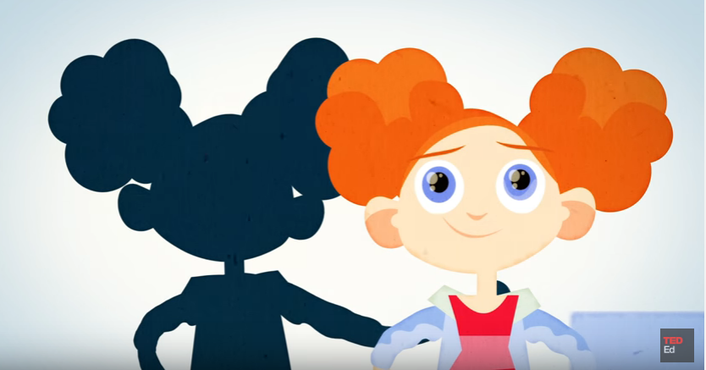
Give our self
a powerful pose
This will boost up our confidence.

Slide 12

TIP 2: Believe in your Ability To Improve
Looking for a long term change
Influence how you act
Growth mind set

Slide 13

Challenge makes the opportunity to learn.
Connection in the brain gets stronger.

Slide 14


TIP 3: Practice Failure
J K Rowling
Wright Brothers

Slide 15

Study says those who fail regularly
Know how to respond to challenges and they go constructive.

Slide 16

Realize nothing is easy and accept that you make mistake.

Slide 17


